Slide 1
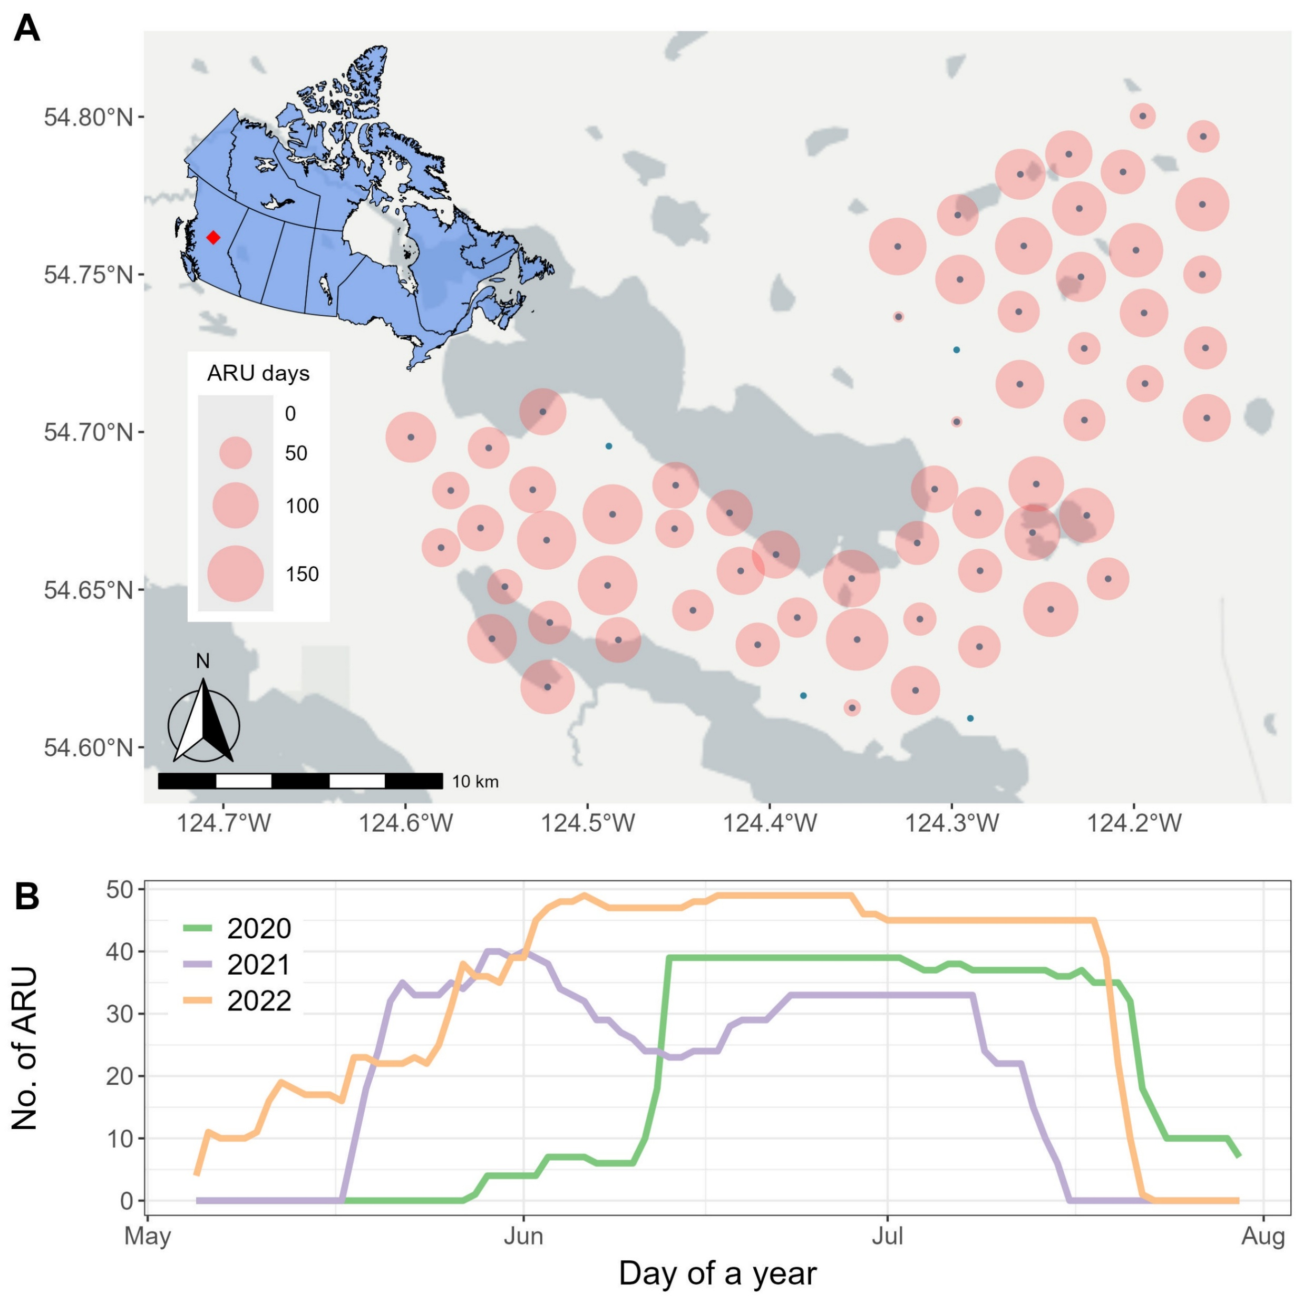
ARU survey effort
Spatial & temporal effort
ARU unit failure
Rain
Wildlife interruption
Battery attachment
Not functioning
…

Slide 2
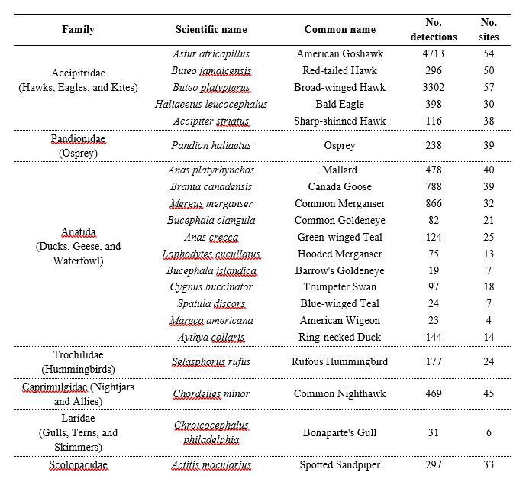
Bird detections
BirdNET processing
Manual validation for determining the # of species
122 bird species
JPRF sound library

Slide 3
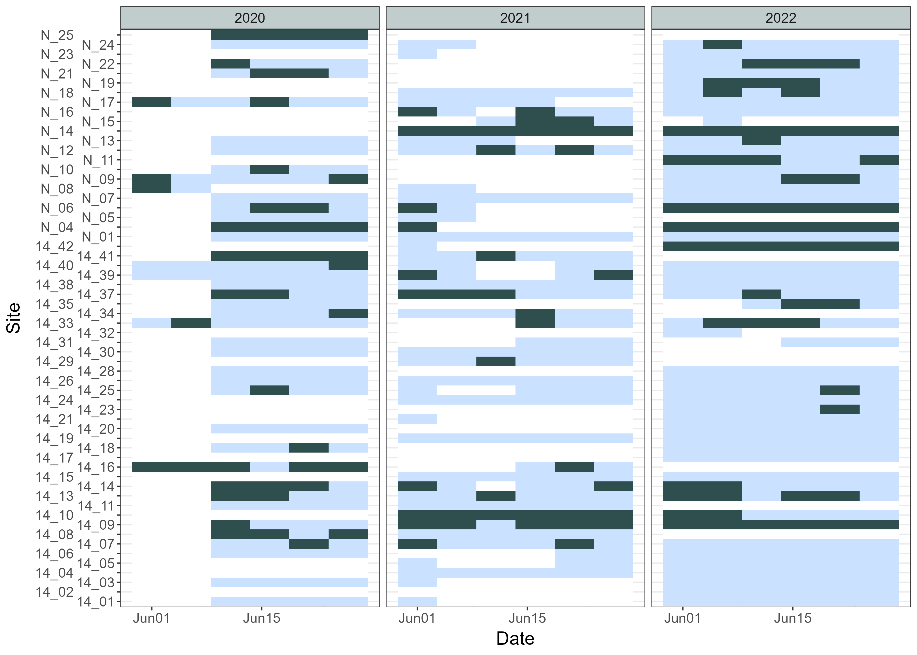
Hotspot mapping
→ Finding the locations in JPRF that support the highest avian diversity
For each of 122 species…
Validated detections for occupancy matrix (when/where is the detection)
Occupancy matrix ~ LiDAR covariates
Predict occupancy probability across JPRF using LiDAR covariate layers
Overlay the maps to locate hotspot

Slide 4
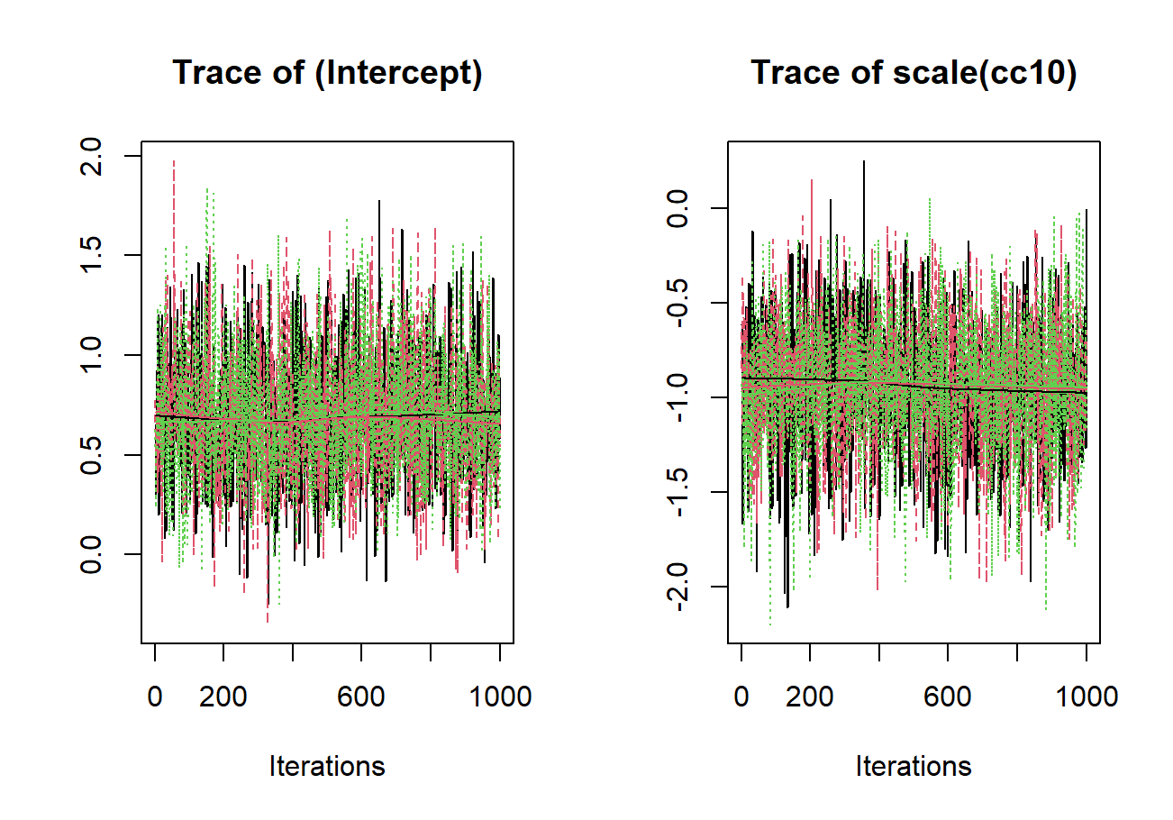
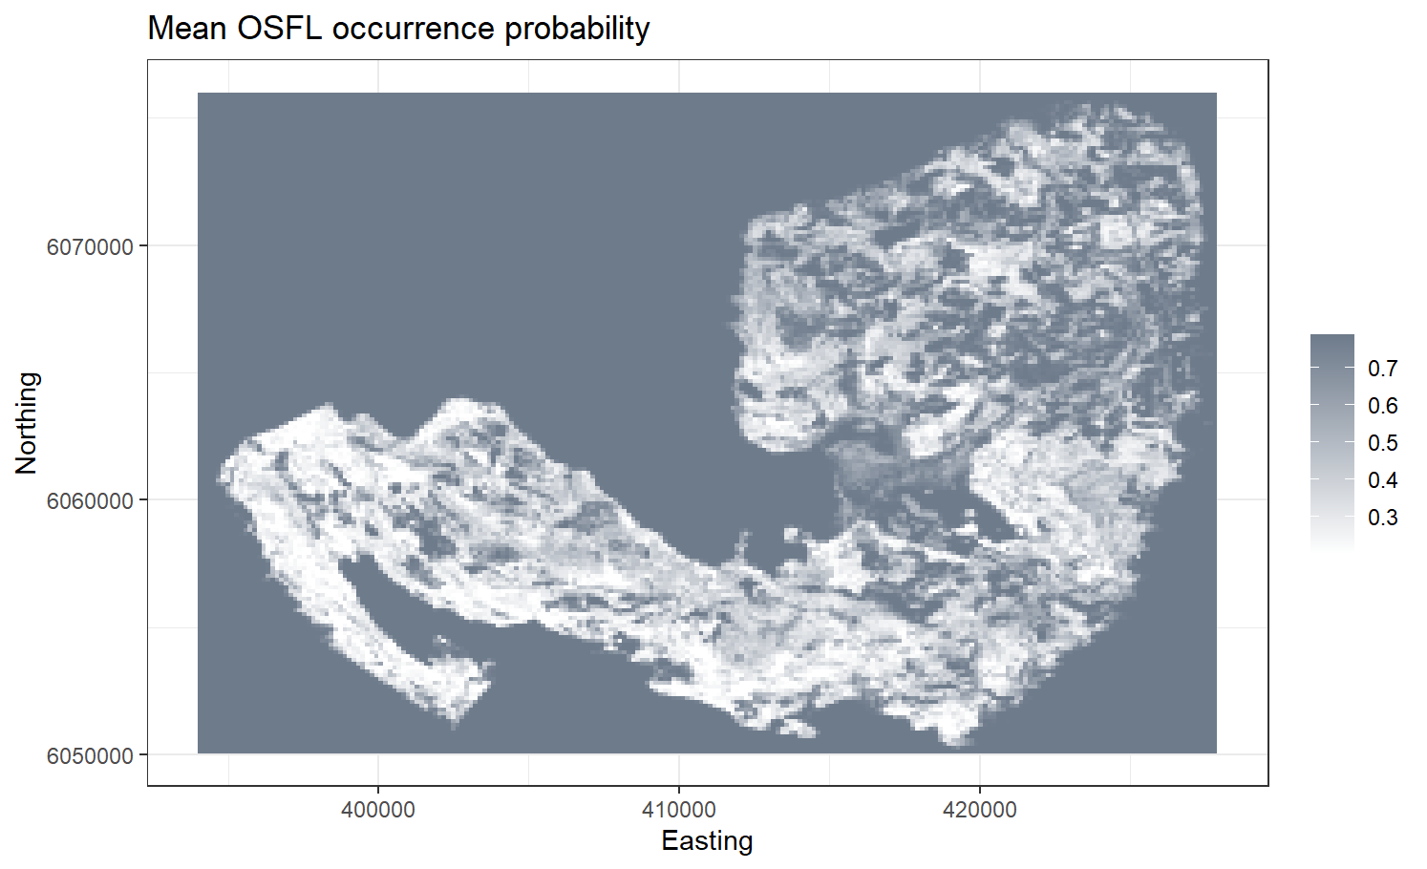
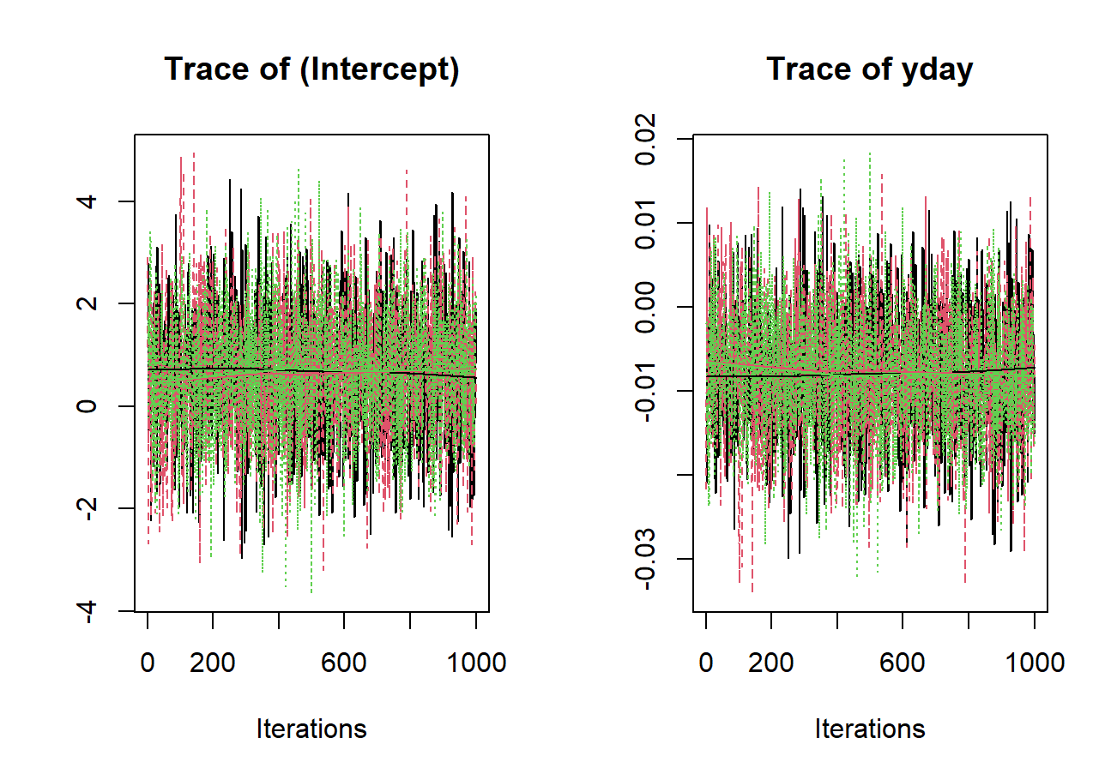
Occupancy probability of OSFL across JPRF
→ used “cc10” (crown coverage above 10m) as occupancy covariate; and “Julian day” as detection covariate

Slide 5
Challenges
Time needed to validate single species is too long (we only have about 40 species validated) → reduce the number of species?
Same as above, it takes manual effort to statistically test the goodness of fit for each species.
Need all the layers of LiDAR covariates across the JPRF → I have a few, but not complete. Are they available?
For each of 122 species…
Validated detections for occupancy matrix (when/where is the detection)
Occupancy matrix ~ LiDAR covariates
Predict occupancy probability across JPRF using LiDAR covariate layers
Overlay the maps to locate hotspot

Slide 6
Potential direction
Use the same method, focus on few species (~5). A methodology paper showing how to use ARU data combining with occupancy modelling.
Use different method, focusing on a group of species (e.g., forest associated species ~ 20). And still focus on predicting the biodiversity.
LiDAR layers.

